Slide 1
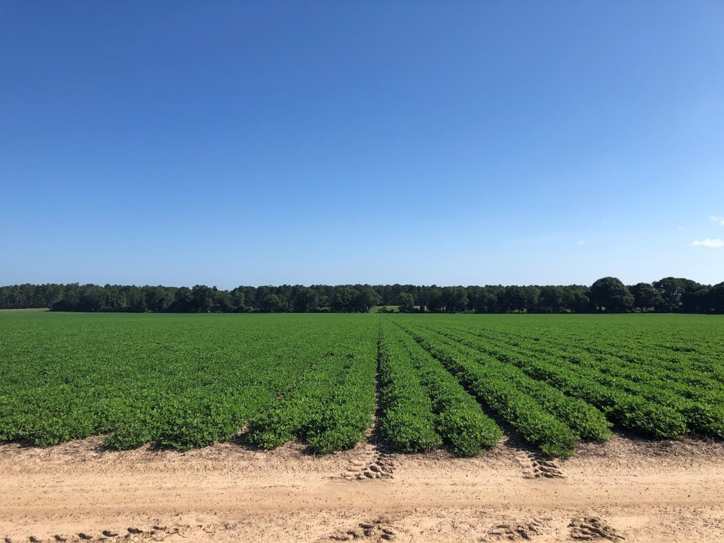
Diagnosing Herbicide
Injury Problems
Eric P. Prostko
Extension Weed Specialist
Dept. Crop & Soil Sciences
University of Georgia
Extension Agent Training
March 19, 2021

Slide 2
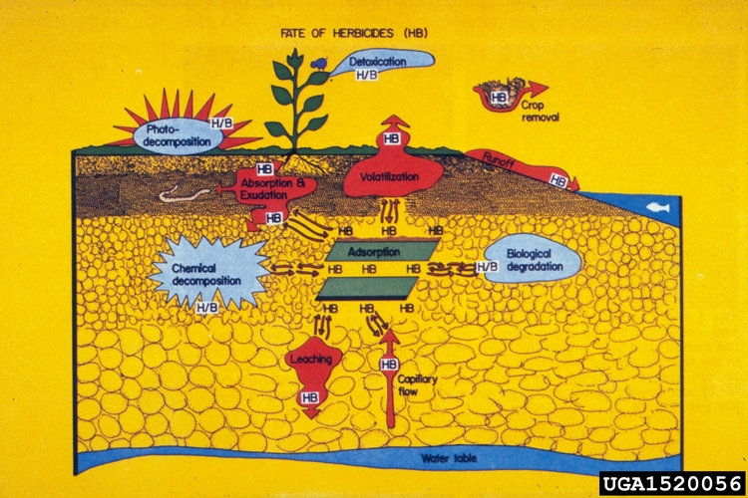
What happens when you spray an herbicide (or any pesticide)?
Drift

Slide 3
Potential Causes of Herbicide Injury
Wrong rate/timing for crop/soil type
  label
  calibration
Off-Target Movement (UPW)
  physical drift
  volatility
Sprayer Contamination
Carryover

Slide 4
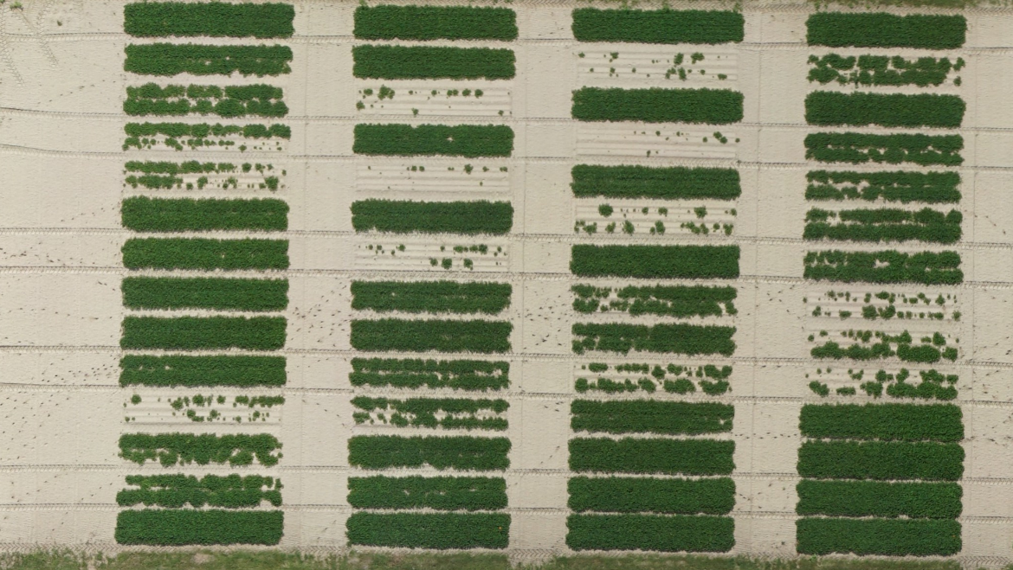







Peanut Variety Response to Brake 1.2SL - 2019
GA-16HO
GA-18RU
GA-06G
4
3
2
1
GA-06G
1 = NTC
2 = 16 oz/A
3 = 32 oz/A
4 = 64 oz/A
PE-04-19
July 7
67 DAP

Slide 5
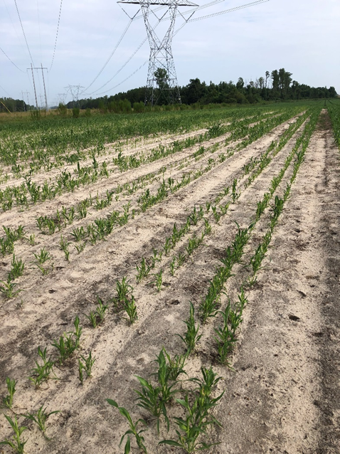
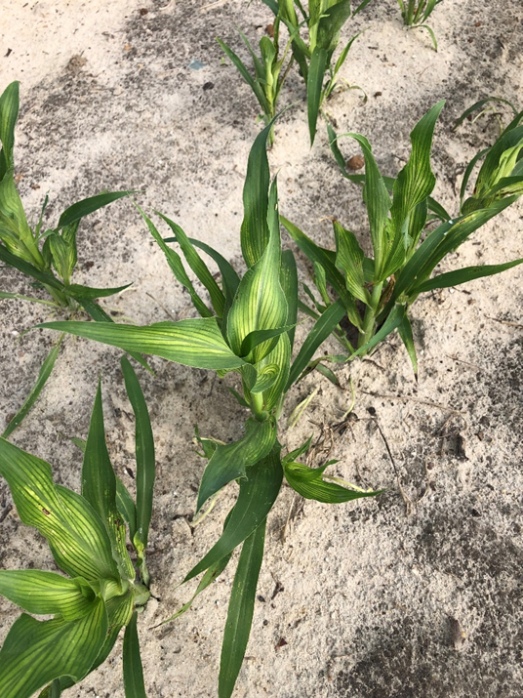
Profine/Sandea (halosulfuron) PRE on Sorghum
Soil pH = 5.7
Nematodes: ring (9)

Slide 6
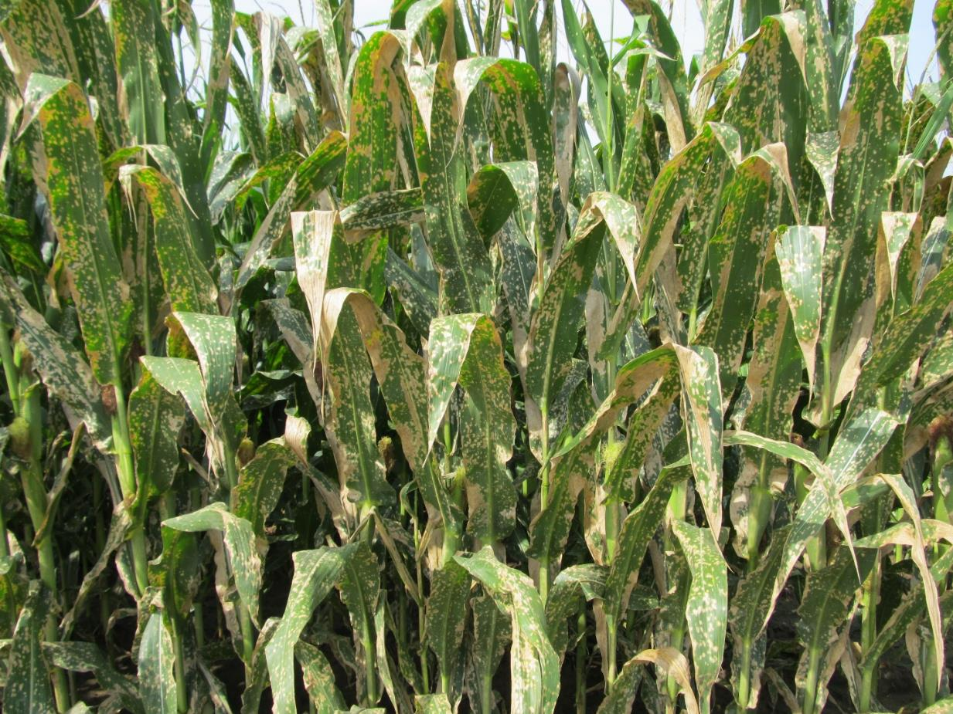
Paraquat Drift

Slide 7
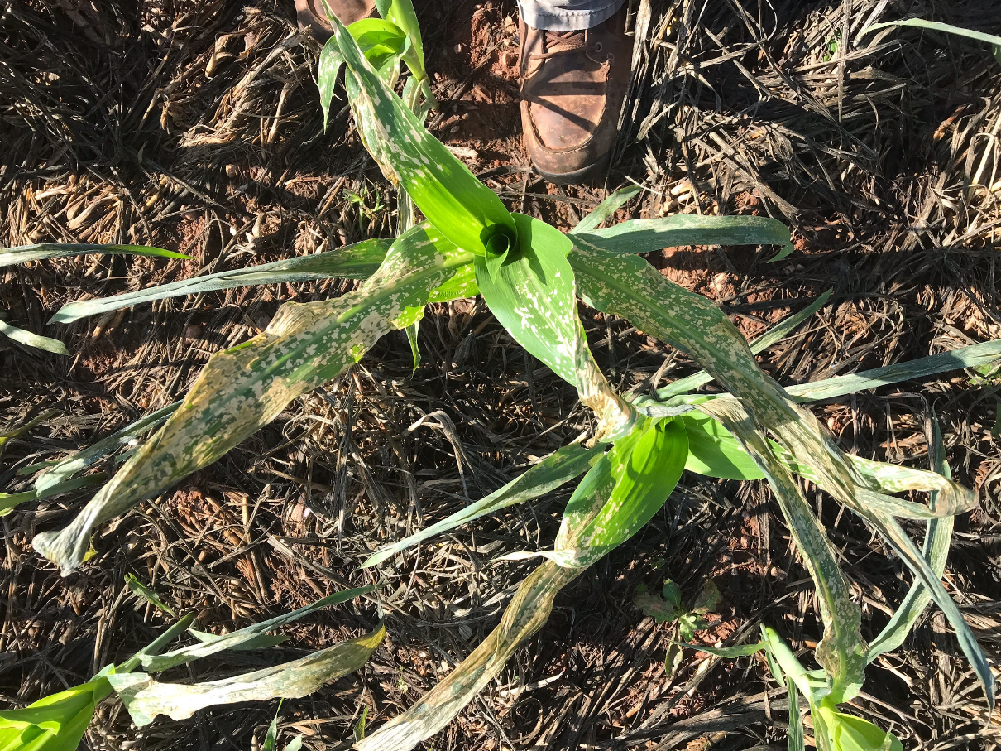
Valor Sprayer Tank-Contamination

Slide 8

Valor/Sprayer Clean-Out
Spray equipment, including mixing vessels and nurse tanks, must be cleaned each day following Valor EZ Herbicide2 application. After Valor EZ Herbicide2 is applied, the following steps must be used to clean the spray equipment:
1. Completely drain the spray tank, rinse the sprayer thoroughly, including the inside and outside of the tank and all in-line screens.
2. Fill the spray tank with clean water and flush all hoses, booms, screens and nozzles.
3. Top off tank, add 1 gallon of 3% household ammonia (or equivalent) for every 100 gallons of water, circulate through sprayer for 5 minutes, and then flush all hoses, booms, screens and nozzles for a minimum of 15 minutes. If diaphragms are being used on the spray boom, loosen diaphragms before flushing the spray system, allowing cleaning solution to spray through the open diaphragm. If spray lines have any end caps, they must be loosened before flushing the system, allowing cleaning solution to spray through the loosened caps. To enhance removal of Valor EZ Herbicide2 from the spray system, add a tank cleaner for example ”Valent Tank Cleaner” from Valent U.S.A. LLC, in place of ammonia and allow the cleaning solution to remain in the pressurized spray system (spray tank, hoses and boom) overnight before flushing the system for a minimum of 15 minutes.
4. Drain tank completely.
5. Add enough clean water to the spray tank to allow all hoses, booms, screens and nozzles to be flushed for 2 minutes.
6. Remove all nozzles and screens and rinse them in clean water. Thoroughly clean spray equipment, including all tanks, hoses, booms, screens and nozzles, cleaned before it is used to apply postemergence pesticides. Equipment with Valor EZ Herbicide2 residue remaining in the system may result in crop injury to the subsequently treated crop.

Slide 9
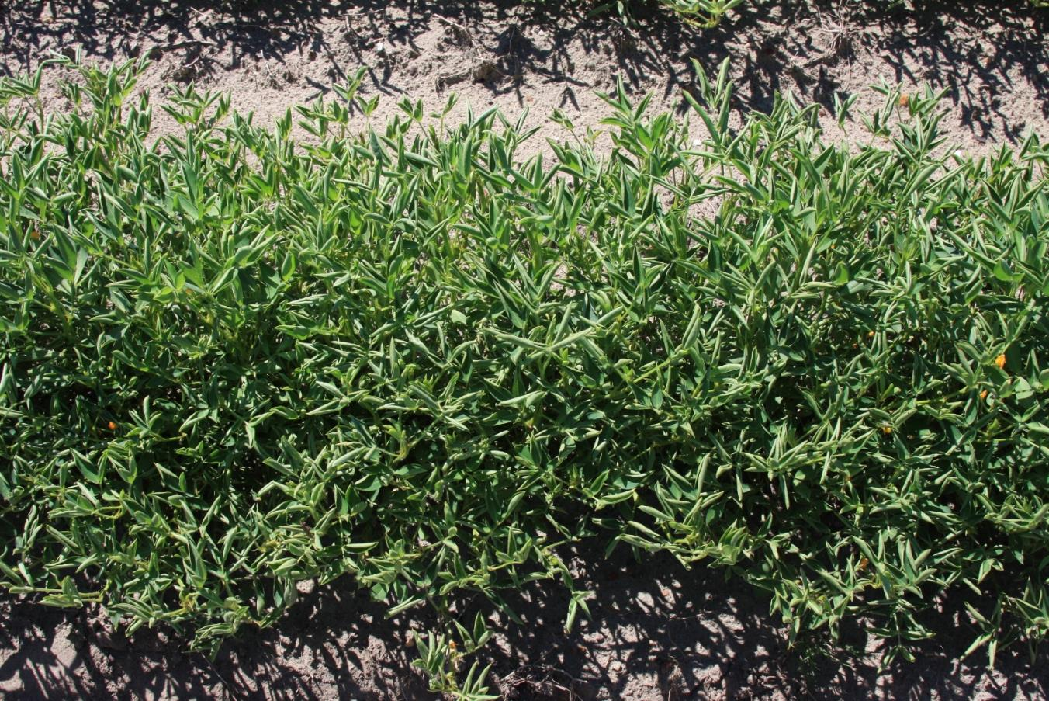
Picloram Carryover to Peanut

Slide 10
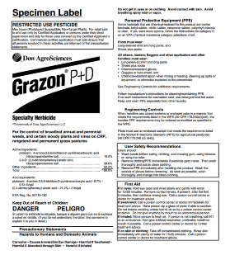
Grazon P+D Label
For the control of broadleaf annual and perennial weeds, and certain woody plants and vines on CRP, rangeland and permanent grass pastures.
On areas treated with this product, do not rotate to crops intended for food or feed use, other than range or pasture grasses, rye, forage sorghum, sudangrass, wheat, barley or oats not underseeded with a legume.
Do not move treated soil, or use treated soil for growing other plants until soil residues of picloram are no longer detectable as indicated by an adequately sensitive bioassay or chemical test.
Do not use grass or hay or plant materials from treated areas or manure from animals being fed treated forage or hay for composting or mulching of desirable, susceptible broadleaf plants.
Do not use manure from animals grazing treated areas on land used for growing broadleaf crops, ornamentals, orchards or other susceptible, desirable plants. Manure may contain enough picloram to cause injury to susceptible plants.

Slide 11
Herbicide Carryover
Has not been that common in GA (at least for me)
Depends upon many factors
  crop/rate/soil texture/OM/pH/tillage/ environment
much of GA is in an environment that favors the breakdown of herbicides
  high rainfall, low OM, lighter soils, soils never freeze

Slide 12
Average Daily Soil Temperatures - 2020
(Optimum soil temperatures for microbial activity are 60-85° F)
Tifton
Source: UGA Weather Network

Slide 13
My Extension Experience
(28 years)
Many, not all, herbicide injury complaints turn out to be something else.
  low soil pH
  nematodes
  soil compaction
Keep a soil/nematode/compaction probe and plastic bags in your truck at all times.
Standard soil testing and grid sampling can often miss hot spots.

Slide 14
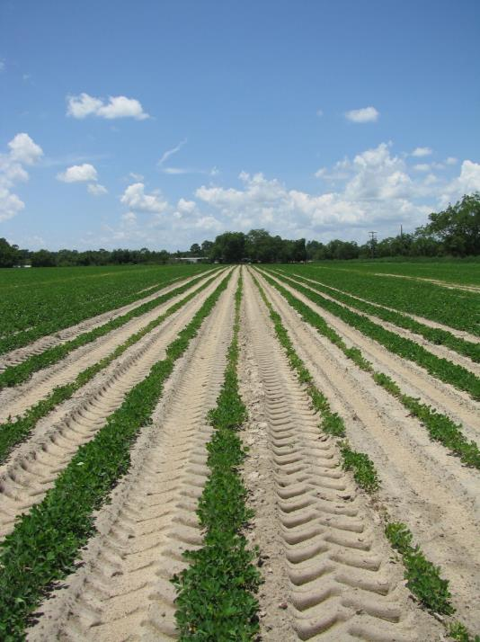
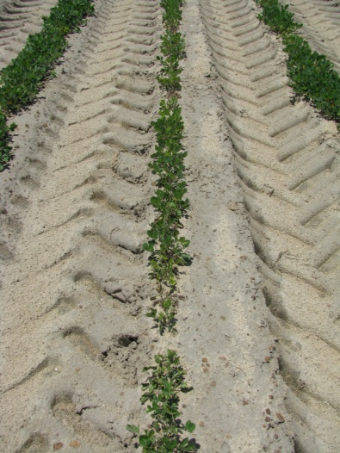
Valor Injury or Soil pH/Zn?
July 2007
pH = 5.04
Zn = 14-17 lbs/a

Slide 15
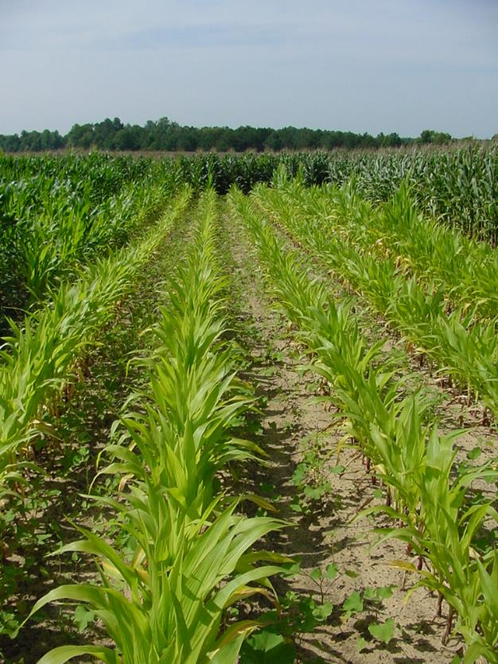
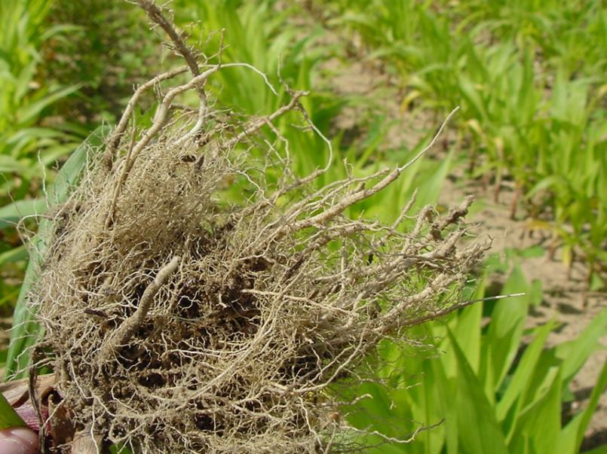
Herbicide Injury or Nematodes???
796-Rootknot nematodes/sample
50+ is a problem

Slide 16
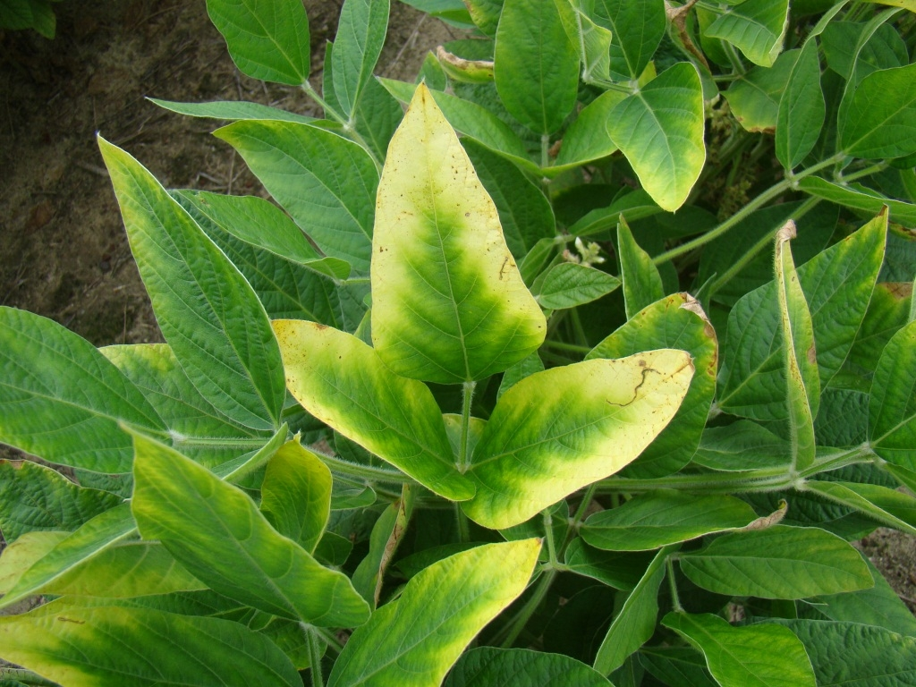
Herbicide Drift or Potassium?
Soybeans are a BIG user of potash (1.14 lbs K₂0 removed/bushel)

Slide 17
Herbicide Symptomology
First and foremost, I am available 24/7 if you need me (229-392-1034)
Purdue University
  https://www.btny.purdue.edu/Extension/Weeds/HerbInj2/InjuryHerb1.html
University of California
  http://herbicidesymptoms.ipm.ucanr.edu/?src=sub
University of Florida
  Cotton (https://edis.ifas.ufl.edu/pdffiles/AG/AG36700.pdf)
  Corn (https://edis.ifas.ufl.edu/pdffiles/AG/AG37400.pdf)
  Peanut (https://edis.ifas.ufl.edu/pdffiles/AG/AG33700.pdf)
Texas A&M University
  Peanut (http://publication.tamu.edu/PEANUTS/PUB_peanuts_Peanut%20Herbicide%20Injury%20Symptomology%20Guide.pdf)
Montana State University
  https://msuextension.org/pubs/herbicideinjuryguide/index.html
Australia Dept. of Primary Industries
  Cotton (https://cotton.ces.ncsu.edu/wp-content/uploads/2015/07/CRC-Herbicide-Symptoms.pdf?fwd=no)
Oregon State University
  Grapes (https://catalog.extension.oregonstate.edu/sites/catalog/files/project/pdf/em8860.pdf)

Slide 18
Herbicide Injury Problems Are Preventable
Read/follow label
Use right rate for soil type
Calibrate sprayer
Follow labeled crop rotation restrictions
Proper sprayer cleanout
  Rush and flush don’t cut it
Avoid off-target movement (UPW)
  situational awareness, wind speed/direction, nozzle type, boom height, speed, pressure, etc.
Do not put herbicides in unlabeled containers

Slide 19
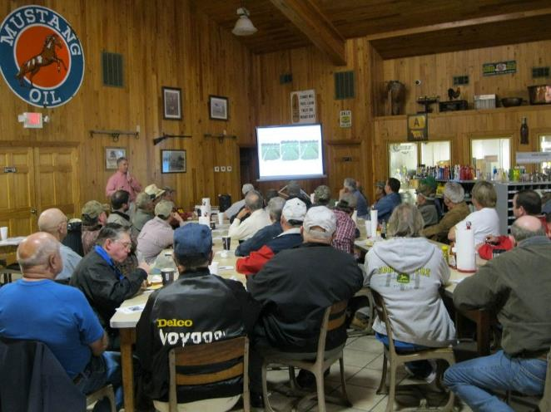
Information You Must Collect
At the very least …
  Last year’s crop
  Last year’s pesticides
  This year’s crop and variety
  This year’s pesticides applied
  Last pesticide in sprayer
  Neighboring crops
Your awesome if you have…
  Soil Test Results
  Nematode Results

Slide 20
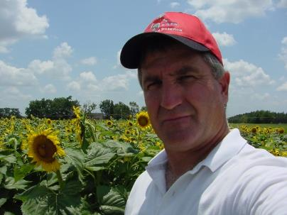
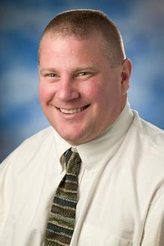
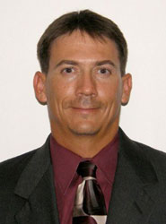
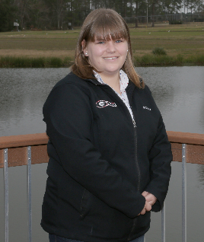


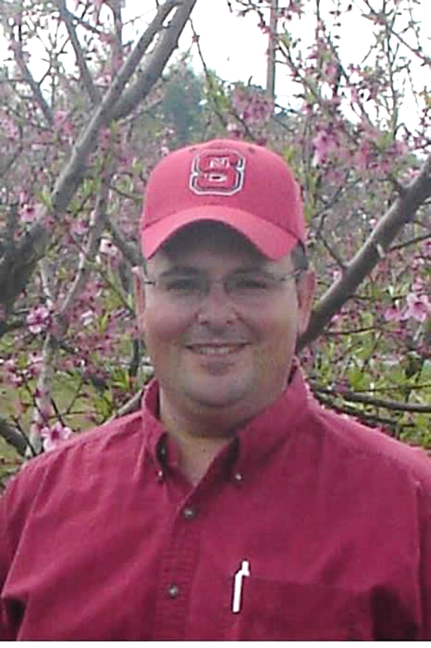
Know Who to Contact
(Your Extension Weed Science Team)
Eric Prostko
Peanuts, soybeans, field corn, sunflowers, grain sorghum, sesame, canola, field pea
Mark Czarnota
Ornamentals, small fruits, nursery,
landscape, greenhouse, Christmas Trees
Lisa Baxter
Forages
Stanley Culpepper
Cotton, small grains,
vegetable crops (including sweet corn)
Patrick McCullough
Turf
Forages
Pastures
Right of Way
Non-crop
Gary Burtle
Ponds/Aquatics
Wayne Mitchem
Tree fruits
(NCSU)

Slide 21
Questions/Comments
Slide set is available at gaweed.com

